Slide 1
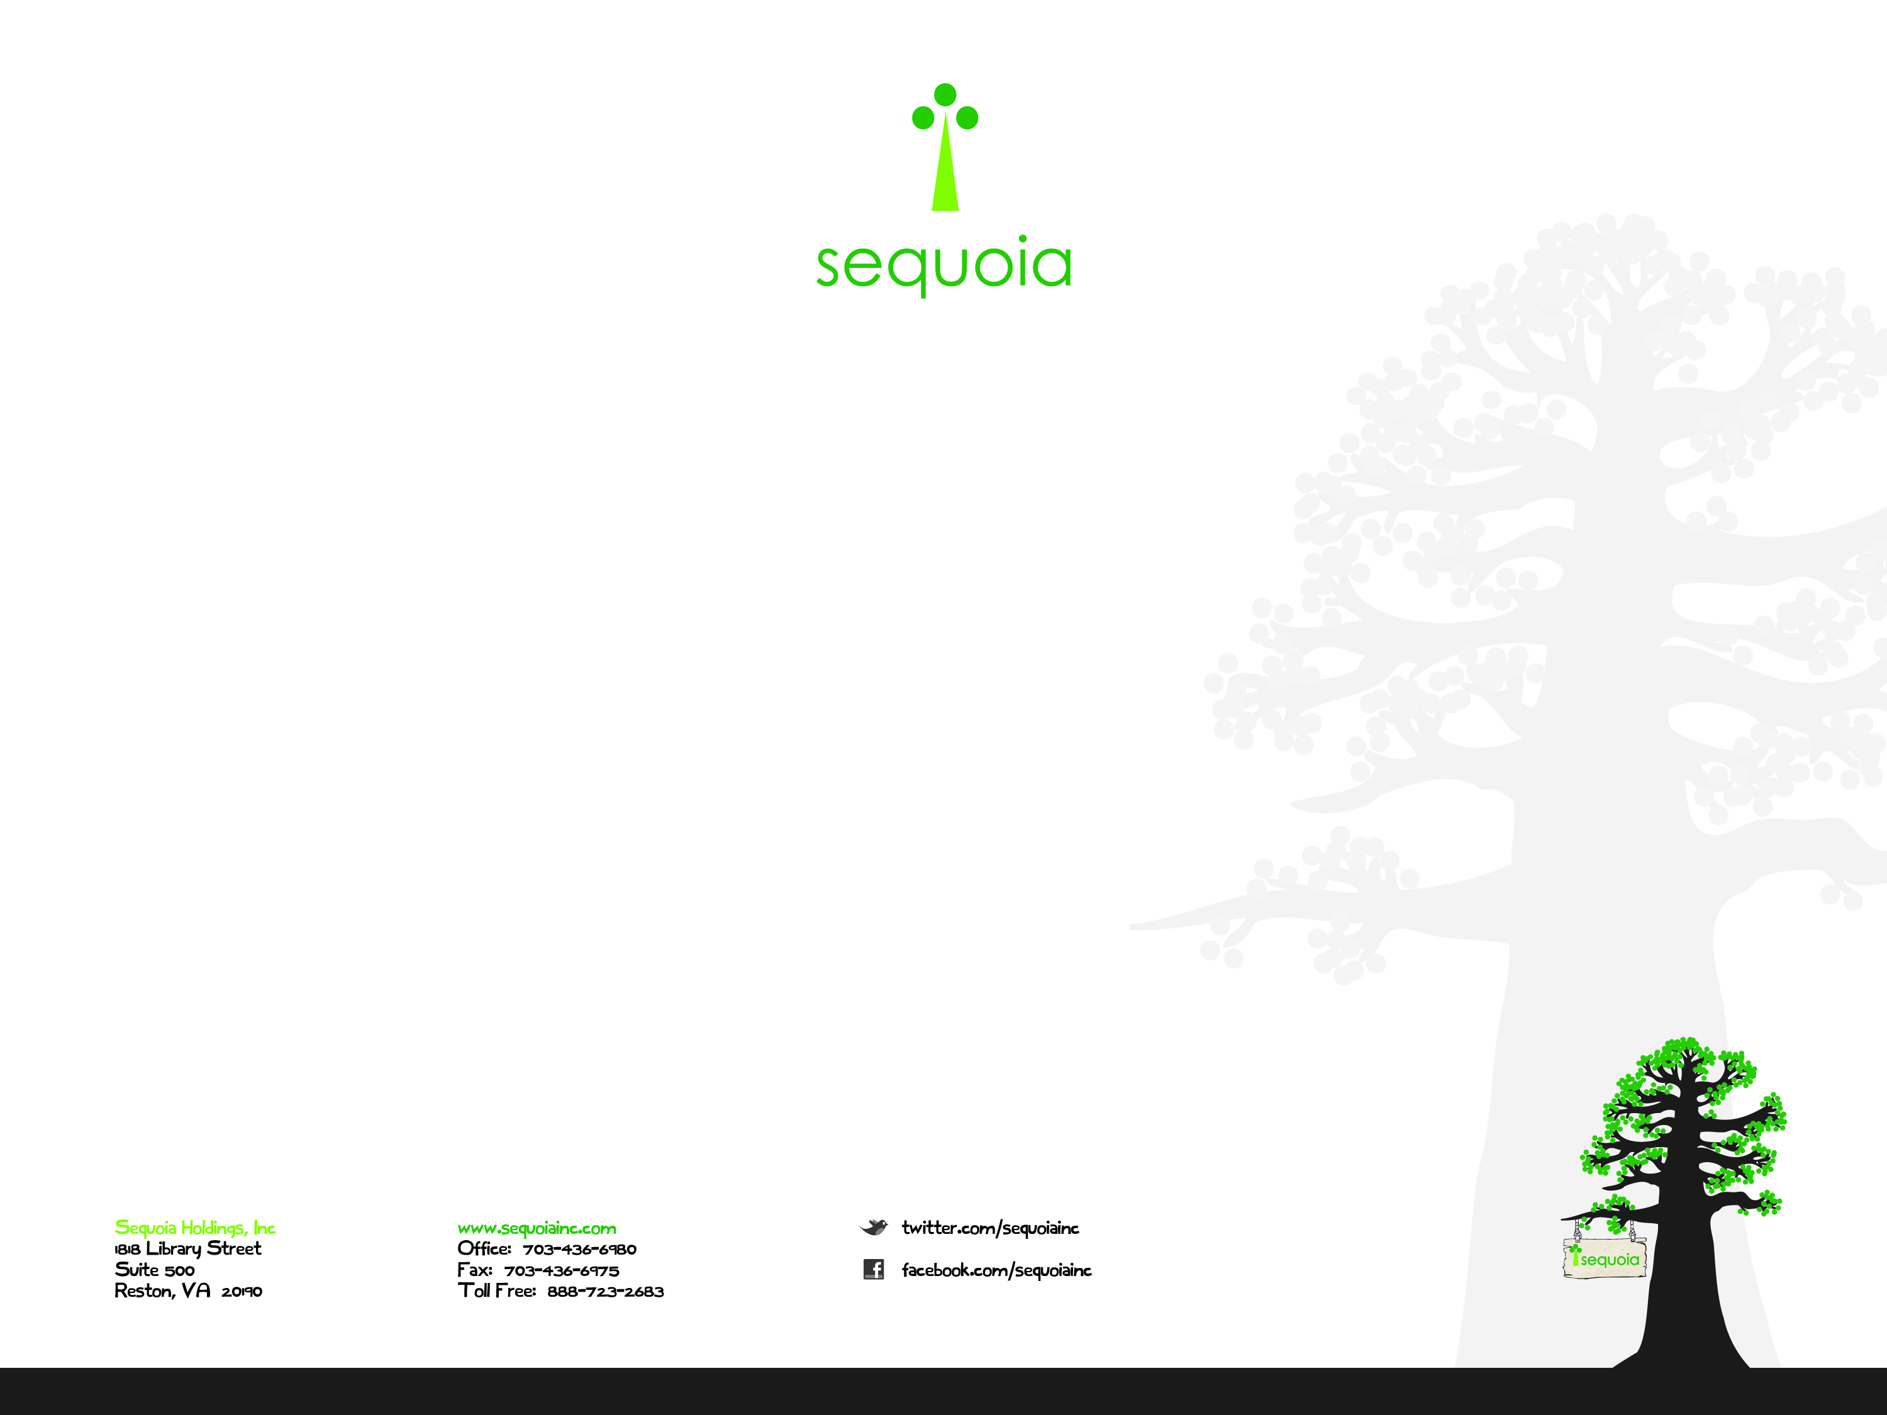
AWS Topics
by Stephen Mouring
Notes:
<number>

Slide 2
Topics
ELB
DynamoDB
Glacier
ElastiCache
Sequoia Holdings, Inc Proprietary and Confidential

Slide 3
ELB
ELB = Elastic Load Balancer
Pro Tip: Does not go around your waist.
Text.
Sequoia Holdings, Inc Proprietary and Confidential

